Slide 1
AI Study Buddy
Team Project - MSc Computer Science
Anika Mayesha – D24125187
Lorenzo Palleschi – D24126922
Rumaysa Babulkhair – D24125711
Yurii Sykal – C23512523

Slide 2

Brief Weekly overview
Logo
DB Architecture
Figma Design
Login / Registrations Page

Slide 3



Logo Prototype
Feedback received about initial design
Adapted centre to be more fitting for study related service

Slide 4
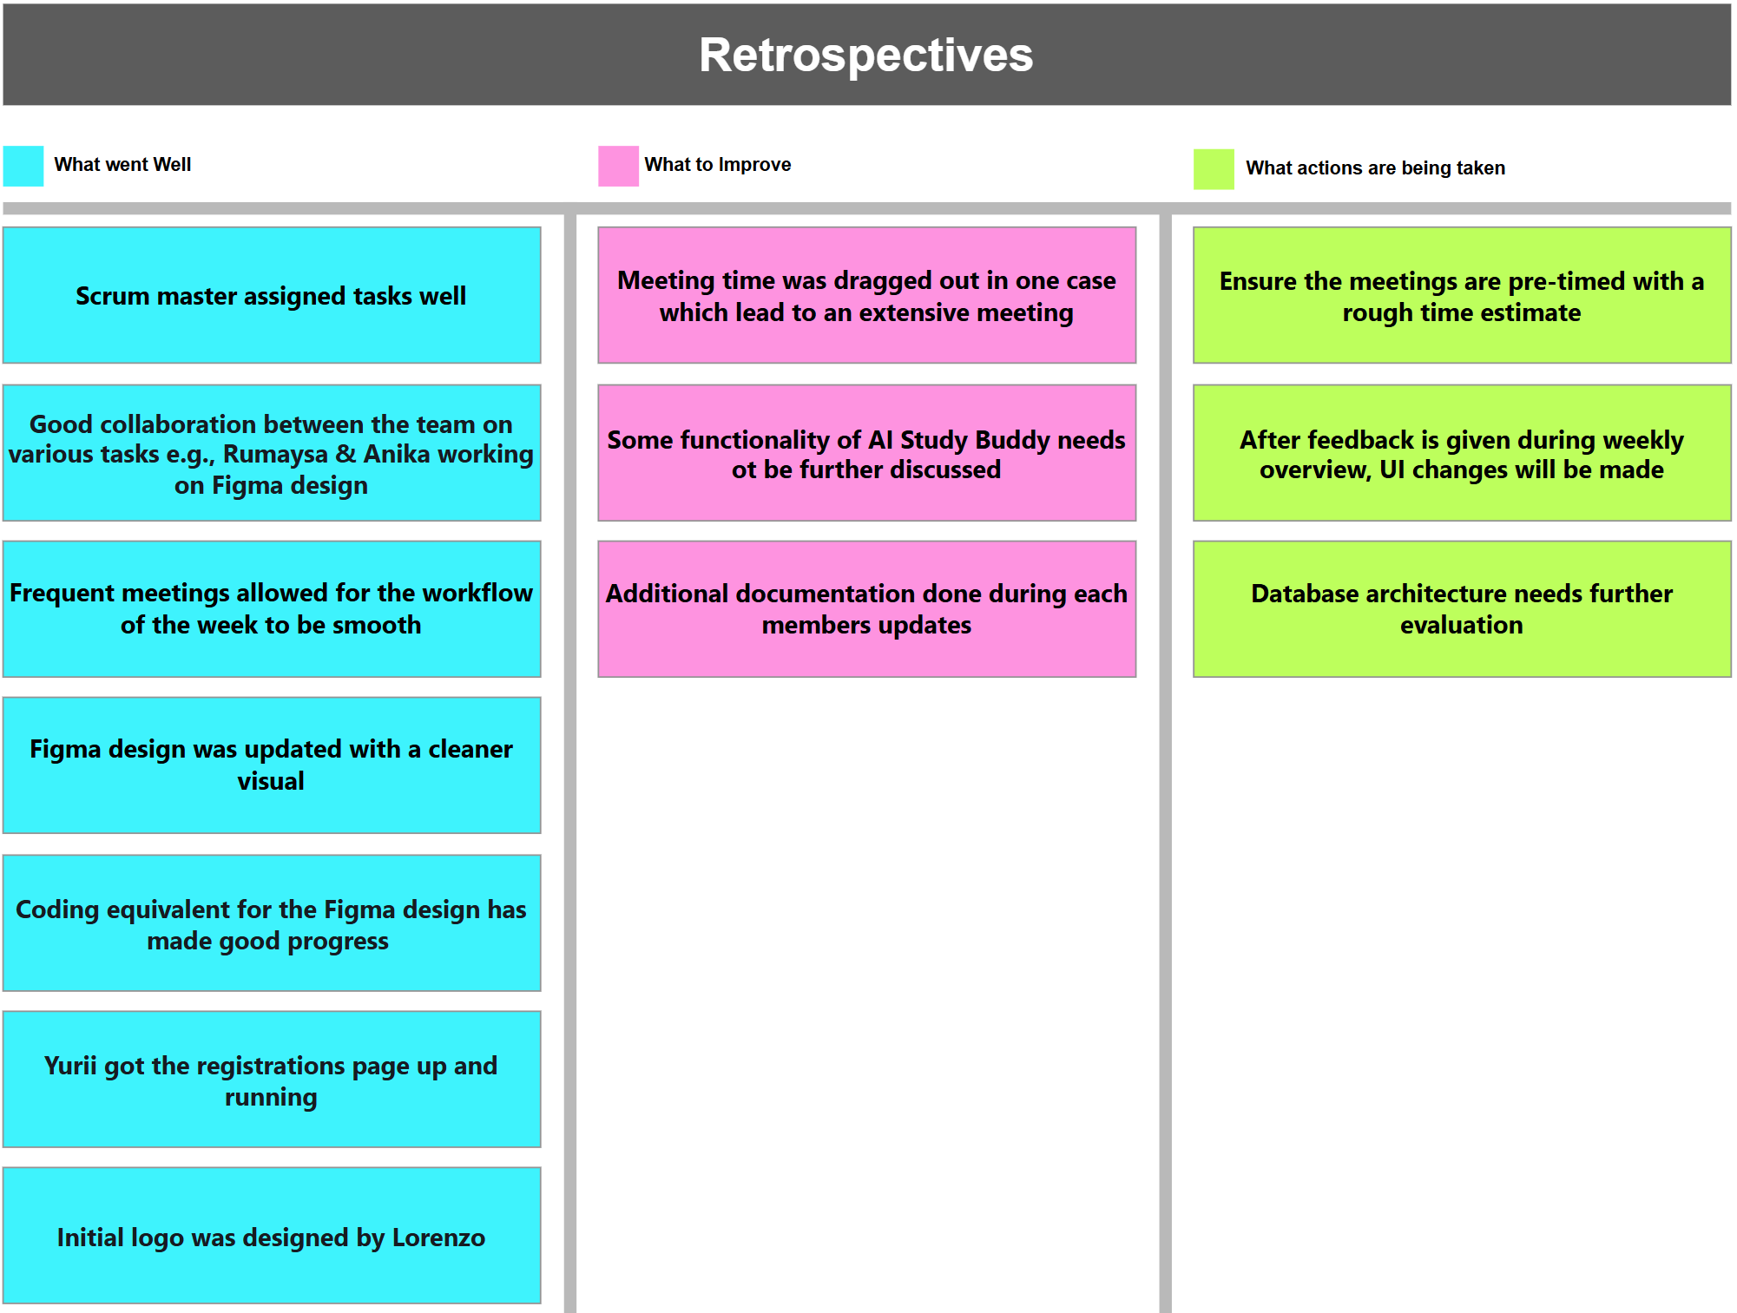

Slide 5
Requirement Specification

Slide 6
Figma Design

Slide 7
Registrations Page

Slide 8
Thank You
Any Questions?

